Slide 1
National Vending Machine Sales
Doug Finck , Cortnee Hill, Reilly Becker

Slide 2
Introduction
How can we increase efficiency of profitable units?
What products are the most profitable by?
Which store location has highest volume use?
Which industries have the highest total sales by region?
What is most important product or machine placement?
How does this data help to make future predictions?

Slide 3
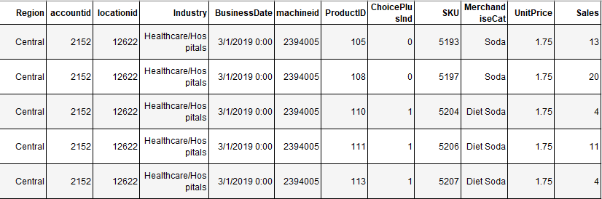
The General Data

Slide 4
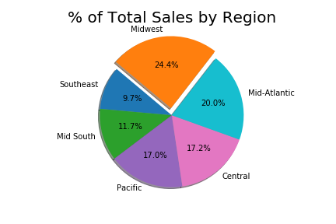
Total Sales

Slide 5
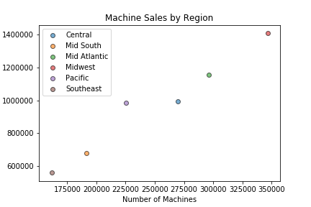
Machine Sales by Region

Slide 6
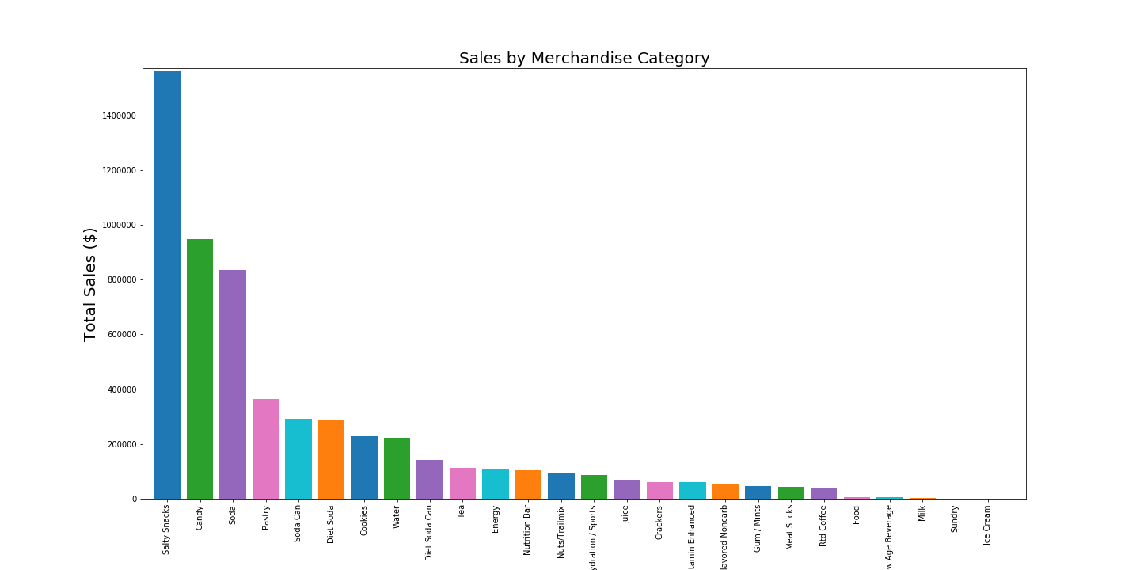
Merch Category Distribution

Slide 7
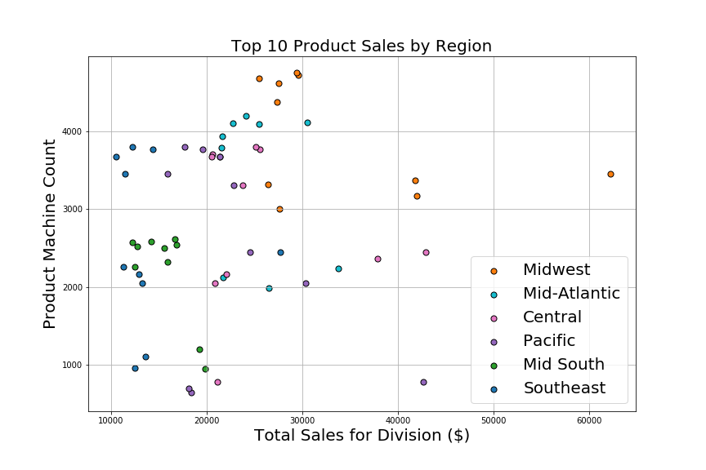
Machine Count/ Sales Ratio Differ by Product

Slide 8
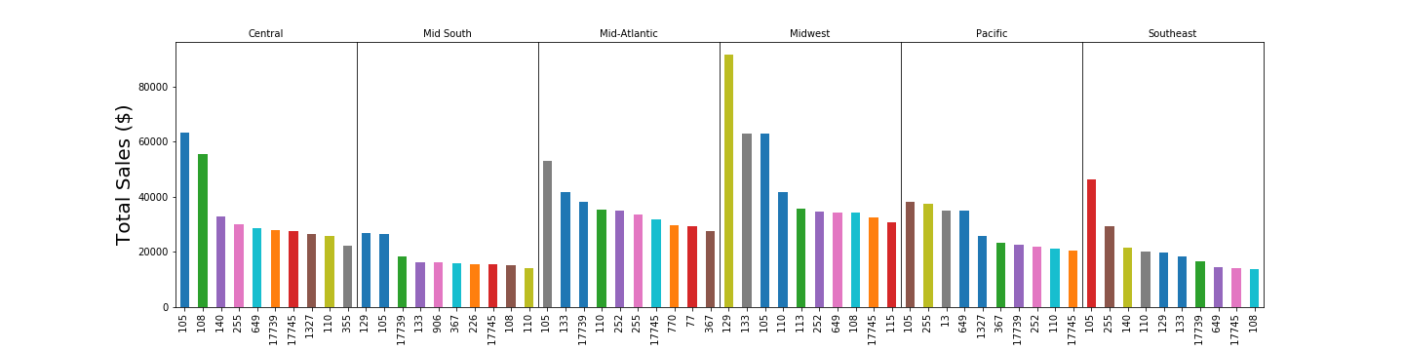
Product Sales by Region

Slide 9
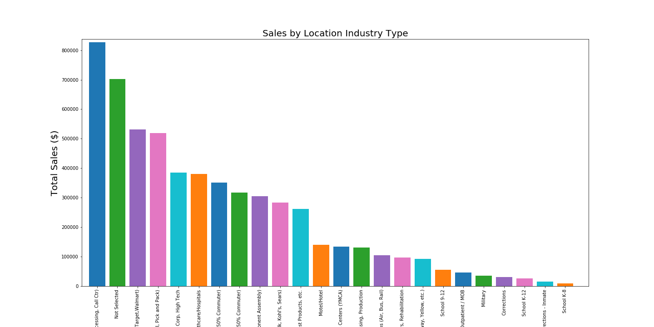
Machine to Building Location

Slide 10
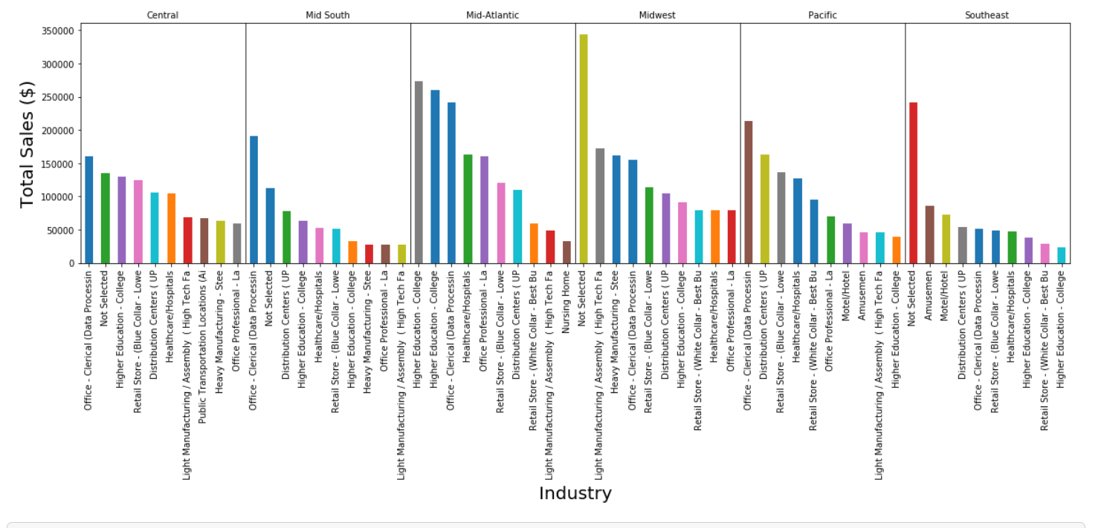
Product Sales by Industry

Slide 11
Conclusion
How can we increase efficiency of profitable units?
-Machine placement (industry) and product demand
What products are the most profitable by?
-Merchandise (static), Product (dynamic)
Which store location has highest volume use?
-Call Centers and Superstores
Which store location has highest volume use?
Which industries have the highest total sales by region?
What is most important product or machine placement?
How does this data help to make future predictions?How can we increase efficiency of profitable units?
What products are the most profitable by?
Which store location has highest volume use?
Which industries have the highest total sales by region?
What is most important product or machine placement?
How does this data help to make future predictions?How can we increase efficiency of profitable units?
What products are the most profitable by?
Which store location has highest volume use?
Which industries have the highest total sales by region?
What is most important product or machine placement?
How does this data help to make future predictions?How can we increase efficiency of profitable units?
What products are the most profitable by?
Which store location has highest volume use?
Which industries have the highest total sales by region?
What is most important product or machine placement?
How does this data help to make future predictions?How can we increase efficiency of profitable units?
What products are the most profitable by?
Which store location has highest volume use?
Which industries have the highest total sales by region?
What is most important product or machine placement?
How does this data help to make future predictions?
Which industries have the highest total sales by region?
-Office (white collar)
What is most important, product or machine placement?
-Both are equally important
How does this data help to make future predictions?
-Results in customer demand

Slide 12
Future Considerations
Sales by zip code
Healthy vs unhealthy
Formulation of most profitable products
Sales trends over time
Price effects on purchase frequency

